Slide 1
Content
Problem.
Solution.
Model 1: Plant Disease Detection Form Leaf Image.
Model 2: Poisonous Plant Identification From Flower Image.
Model 3: Plant Identification From Leaf Images.

Slide 2
Problem.
1. Difficulty in Accurate Plant Identification
Many plants look similar, making manual identification error-prone.
Traditional methods require expert botanists, which are not always available.
2. Challenges in Detecting Plant Diseases
Early-stage diseases are often visually subtle and missed by farmers.
Delayed or incorrect diagnosis leads to crop loss and reduced yield.
Current disease detection methods are time-consuming and require lab testing.
3. Risk of Poisonous Plant Exposure
Many toxic plants resemble non-toxic ones, leading to accidental consumption.
Common victims include children, hikers, and foraging enthusiasts.

Slide 3
Solution
We need to build three AI based models for 1. Plant disease detection from leaf image, 2. Poisonous plant identification from flower image. and 3. Plant identification from leaf image.
We need to build 3 separate models in Deep Learning.
We need to collect images for each problem (disease leaf images, poisonous leaf images, etc).
Organize and prepare the images data for the model.
Choose a Deep learning model first.
Train the model/algorithm using the dataset.
Test and evaluate the trained model.

Slide 4
Model 1:
Plant Disease Detection From Leaf Image.

Slide 5
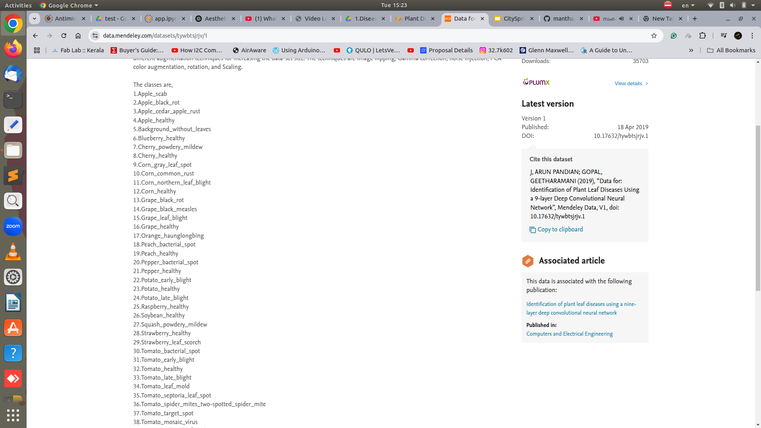
Model 1: Plant Disease Detection
Data Collection:
The dataset of plant disease leaf images are collected from https://data.mendeley.com/datasets/tywbtsjrjv/1
Details of the dataset:
Total number of images = 61486
Total number of diseases = 39

Slide 6
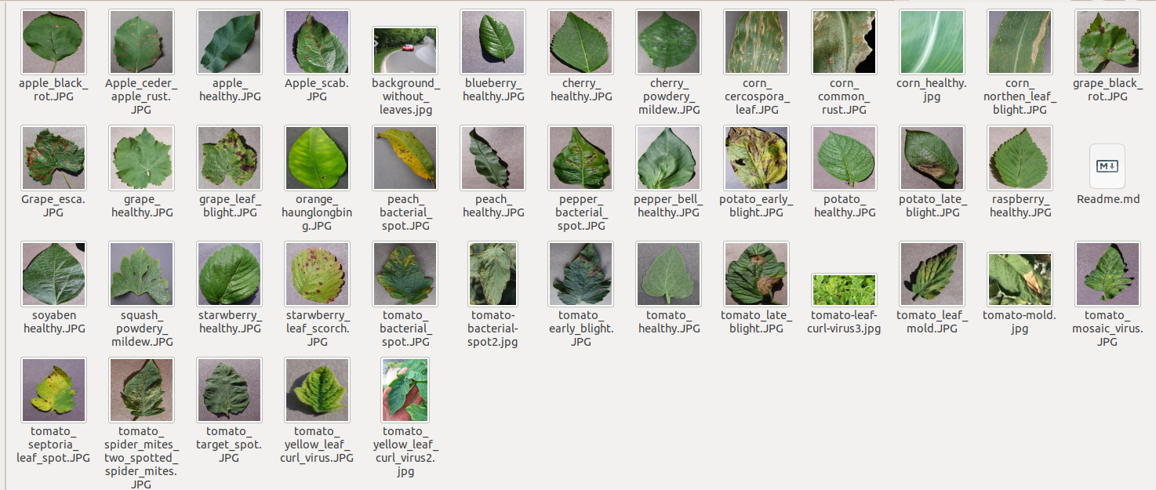
Model 1: Plant Disease Detection
Data Collection:
Sample

Slide 7
Model 1: Plant Disease Detection
Model development:
The model or algorithm choose is a CNN-based algorithm called VGGNet.
It is a pre-trained model which we can re-train with our dataset.
CNN (Convolutional Neural Network) - mathematical operation that has the ability to learn what is in an image.
CNN runs through the nook and corner of an input image and learns low level features like pixels and high level features like edges, curves, etc.
After training, CNN can be used for automatic recognition.
VGGnet is a series of CNN operations that search for the trained object.
We train VGGNet with images of disease leaves.
The algorithm will be developed and trained in Google Colab environment/IDE.
Using Python language and python supporting libraries like pytorch, tensorflow, etc.

Slide 8
Model 1: Plant Disease Detection

Slide 9
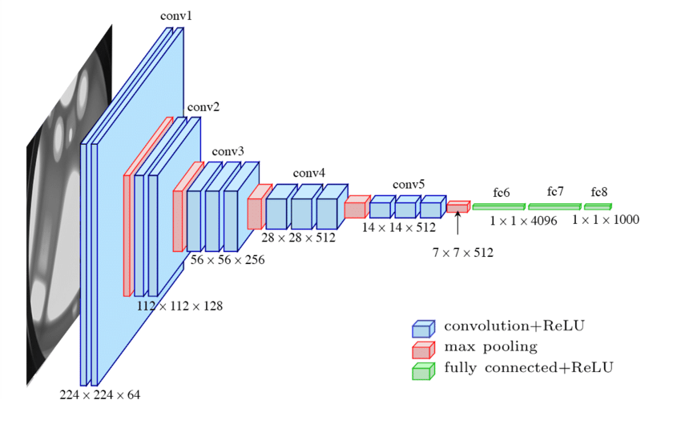
Model 1: Plant Disease Detection
VGGnet architecture made of CNN layers

Slide 10
Model 1: Plant Disease Detection
Model development:
The CNN model is coded in Python in Google Colab and trained.
Training details:
Trained till Training accuracy = 96.7% and Test Accuracy = 98.9%
Tested the model with input images.
Added results like detected disease, description of the disease, prevention methods, supplement to buy, link to buy, etc.
So the model can detect 39 types of plant diseases from leaf images.

Slide 11
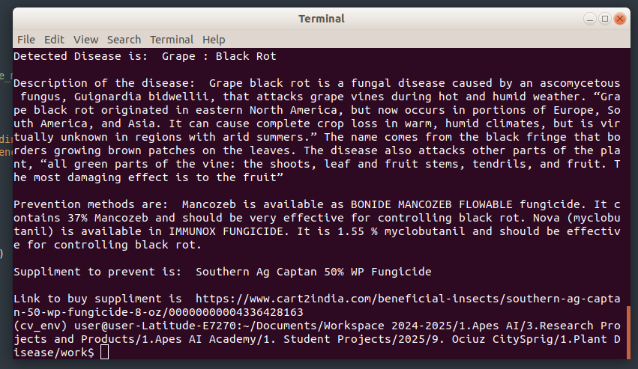
Model 1: Plant Disease Detection

Slide 12
Model 2:
Poisonous Plant Identification From Flower Image

Slide 13
Model 2: Poisonous Plant Identification From Flower Image
Data Collection:
The dataset of poisonous flower images are collected from https://www.kaggle.com/datasets/nitron/poisonous-plants-images
Details of the dataset:
Types of poisonous flowers = 8
Total number of images = 511 images
Number of images in each flower category = 40 images for training CNN algorithm.
Types of flowers = ['dieffenbachia', 'lily_of_the_valley', 'lilies', 'foxglove', 'oleander', 'castor_oil_plant', 'wisteria', 'rhubarb']

Slide 14
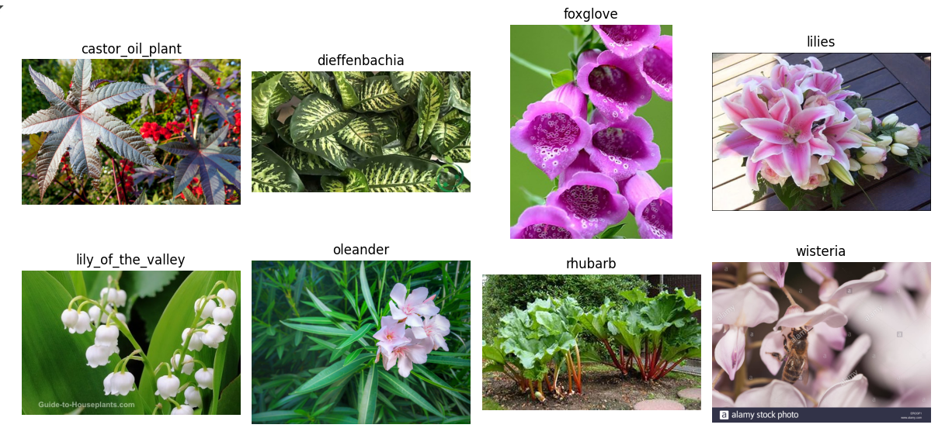
Model 2: Poisonous Plant Identification From Flower Image

Slide 15
Model 2: Poisonous Plant Identification From Flower Image
Model development:
The model or algorithm choose is a CNN-based algorithm called VGGNet.
The same VGGNet algorithm is used.
The CNN model is coded in Python in Google Colab and trained.
Training details:
Trained till Training accuracy = 93.47% and Test Accuracy = 81.93%
Tested the model with input images.

Slide 16
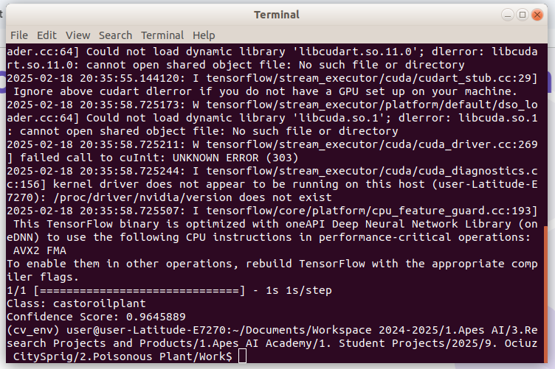
Model 2: Poisonous Plant Identification From Flower Image

Slide 17
Model 3: Plant identification from Leaf Image.

Slide 18
Model 3: Plant identification from Leaf images
Data Collection:
The dataset of Plant leaves are collected from https://www.kaggle.com/datasets/aryashah2k/indian-medicinal-leaves-dataset
Details of the dataset:
Types of plants = 40
Total number of images = 9323 (5985 images for training and 2378 images for validation)
Types of plants = [ 'Aloe Vera', 'Amla', 'Amruta Balli', 'Arali', 'Ashoka', 'Ashwagandha', 'Avocado', 'Bamboo', 'Basale', 'Betel', 'Betel Nut', 'Brahmi', 'Castor', 'Curry Leaf', 'Doddapatre', 'Ekka', 'Ganike', 'Guava', 'Geranium', 'Henna', 'Hibiscus', 'Honge', 'Insulin', 'Jasmine', 'Lemon', 'Lemon Grass', 'Mango', 'Mint', 'Nagadali', 'Neem', 'Nithyapushpa', 'Nooni', 'Papaya', 'Pepper', 'Pomegranate', 'Raktachandini', 'Rose', 'Sapota', 'Tulsi', 'Wood Sorel' ]

Slide 19
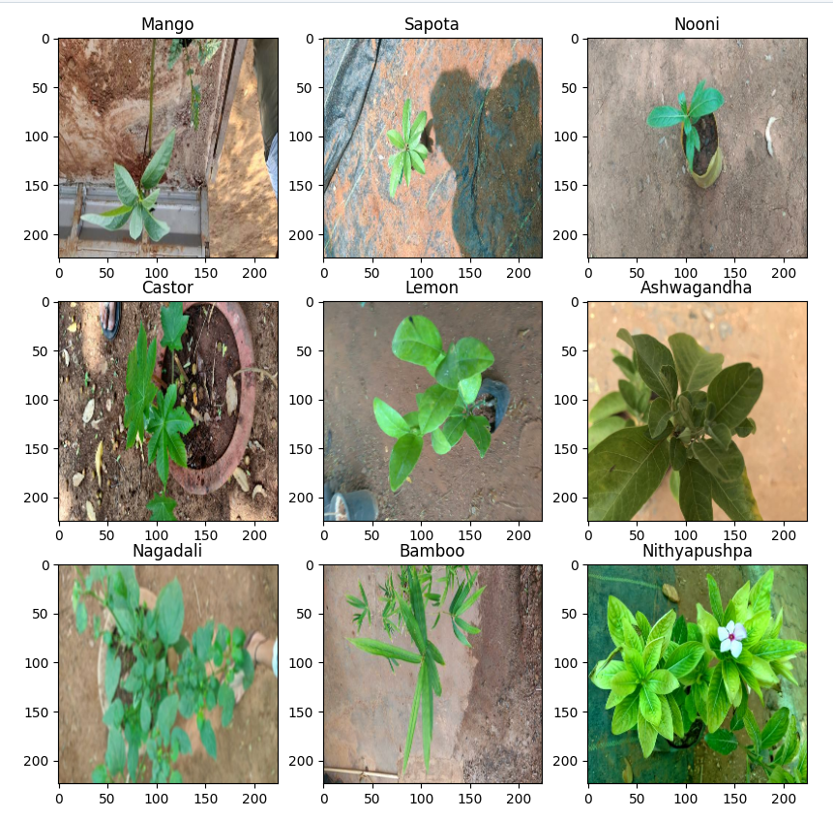
Model 3: Plant identification from Leaf images

Slide 20
Model 3: Plant identification from Leaf images
Model development:
The model or algorithm choose is a CNN-based algorithm called VGGNet.
The same VGGNet algorithm is used.
The CNN model is coded in Python in Google Colab and trained.
Training details:
Trained till Training accuracy = 98.01% and Test Accuracy = 93.91%
Tested the model with input images.
In addition to the identified plant name, other details like description of the plant and its uses are added in the result.

Slide 21
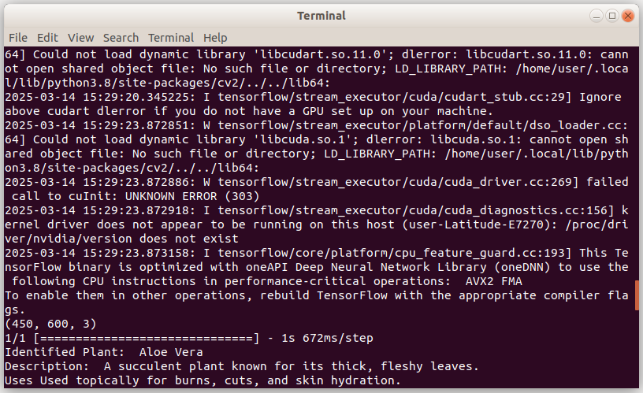
Model 3: Plant identification from Leaf images

